Slide 1
Engagement insight engine
Ramesh Kuntigorla

Slide 2
Problem statement
I was tasked to create an Engagement insight engine, which will suggest profile improvements for the user on basis of his usage data.
This becomes really important to improve user engagement on our platform and enhances user experience in the app.

Slide 3
Objectives
KEY GOALS:
Identifying the usage patterns
Preparing a dataset for the model to train and to suggest the nudges.
Classify and show nudges based on user engagement data , override with deterministic rules if a conflict arrives.
OUTCOMES:
Achieving 80% > above accuracy on engagement level prediction.
Low false-positive rate for highly engaged users.

Slide 4
Data preprocessing
Missing values: No missing values found in dataset since we are using synthetically created dataset which was generated by the given deterministic rules.
Feature Engineering: Created a custom feature called “event_fomo_score” which shows the users fomo level on the scale of 0 to 1. Buddy attendance factor (40% weight), Batch attendance factor (30% weight) and Time decay factor (30% weight)
Feature scaling: No feature scaling required since we are dealing with random forest model.
Data Balancing: Applied balanced sampling techniques to address class imbalance
Encoding: One hot encoded some of labels.

Slide 5
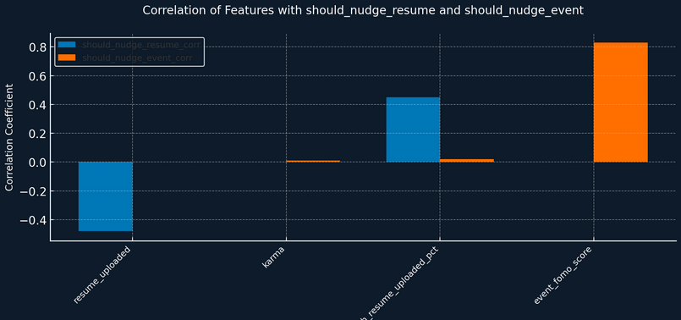
EDA

Slide 6
EDA
From the above graph we can see that the event fomo score is highly effecting the should_nudge_event variable while batch_resume_pct and resume_uploaded variables highly effecting the should_nudge_resume variable.
This forms basis for the model on how to classify the data.

Slide 7
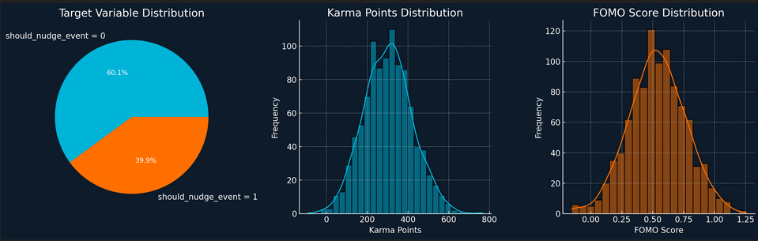
EVENT DATASET DISTRIBUTION

Slide 8
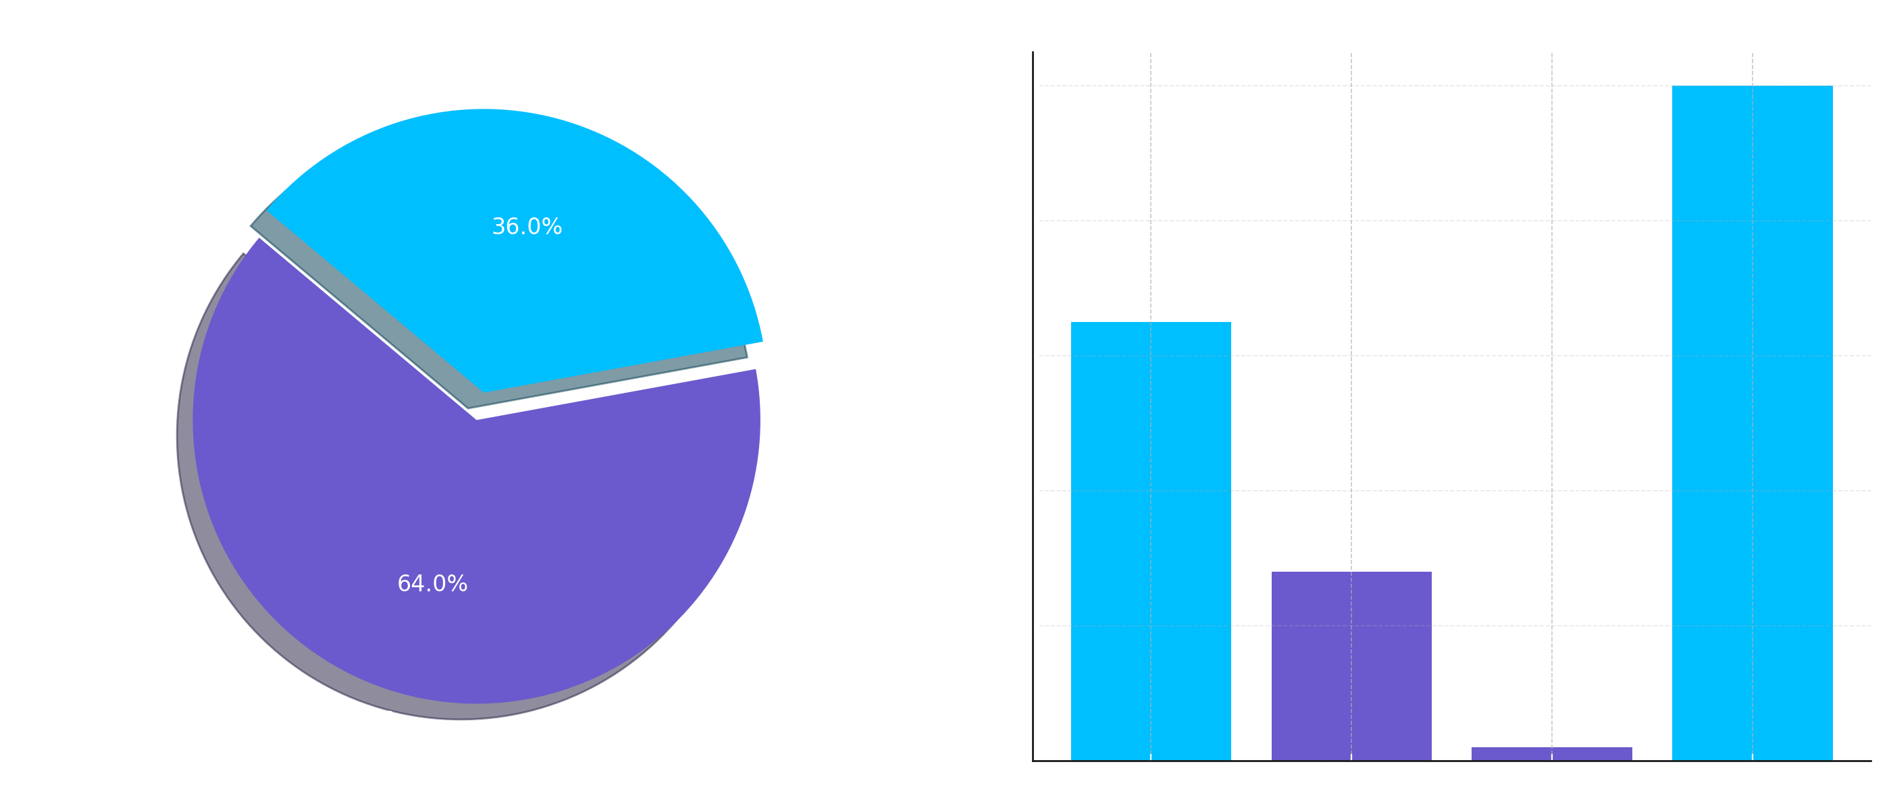
Resume dataset distribution

Slide 9
MODEl selection
Models Considered
1. Neural Networks (TensorFlow/Keras)
- Architecture: 2 hidden layers (64, 32 neurons)
- Activation: ReLU with BatchNormalization and Dropout
- Output: Sigmoid for binary classification
2. Random Forest Classifier
- Estimators: 100 trees
- Max depth: None (unlimited)
- Random state: 42 for reproducibility
3. Support Vector Machines (briefly explored)
- Limited exploration due to computational complexity

Slide 10
Model evaluation
Accuracy: Overall prediction correctness
Precision: True positives / (True positives + False positives)
Recall: True positives / (True positives + False negatives)
F1-Score: Harmonic mean of precision and recall
Confusion Matrix: Detailed error analysis

Slide 11
Final Model Selection
Random Forest Classifier was chosen as the production model for both tasks:
Justification:
Performance: Achieved 96% accuracy for resume prediction and 81% accuracy for event prediction
Interpretability: Feature importance analysis provides business insights
Robustness: Handles noise well and doesn't require feature scaling
Speed: Fast inference times suitable for real-time API responses
Simplicity: Easier to deploy and maintain compared to neural networks

Slide 12
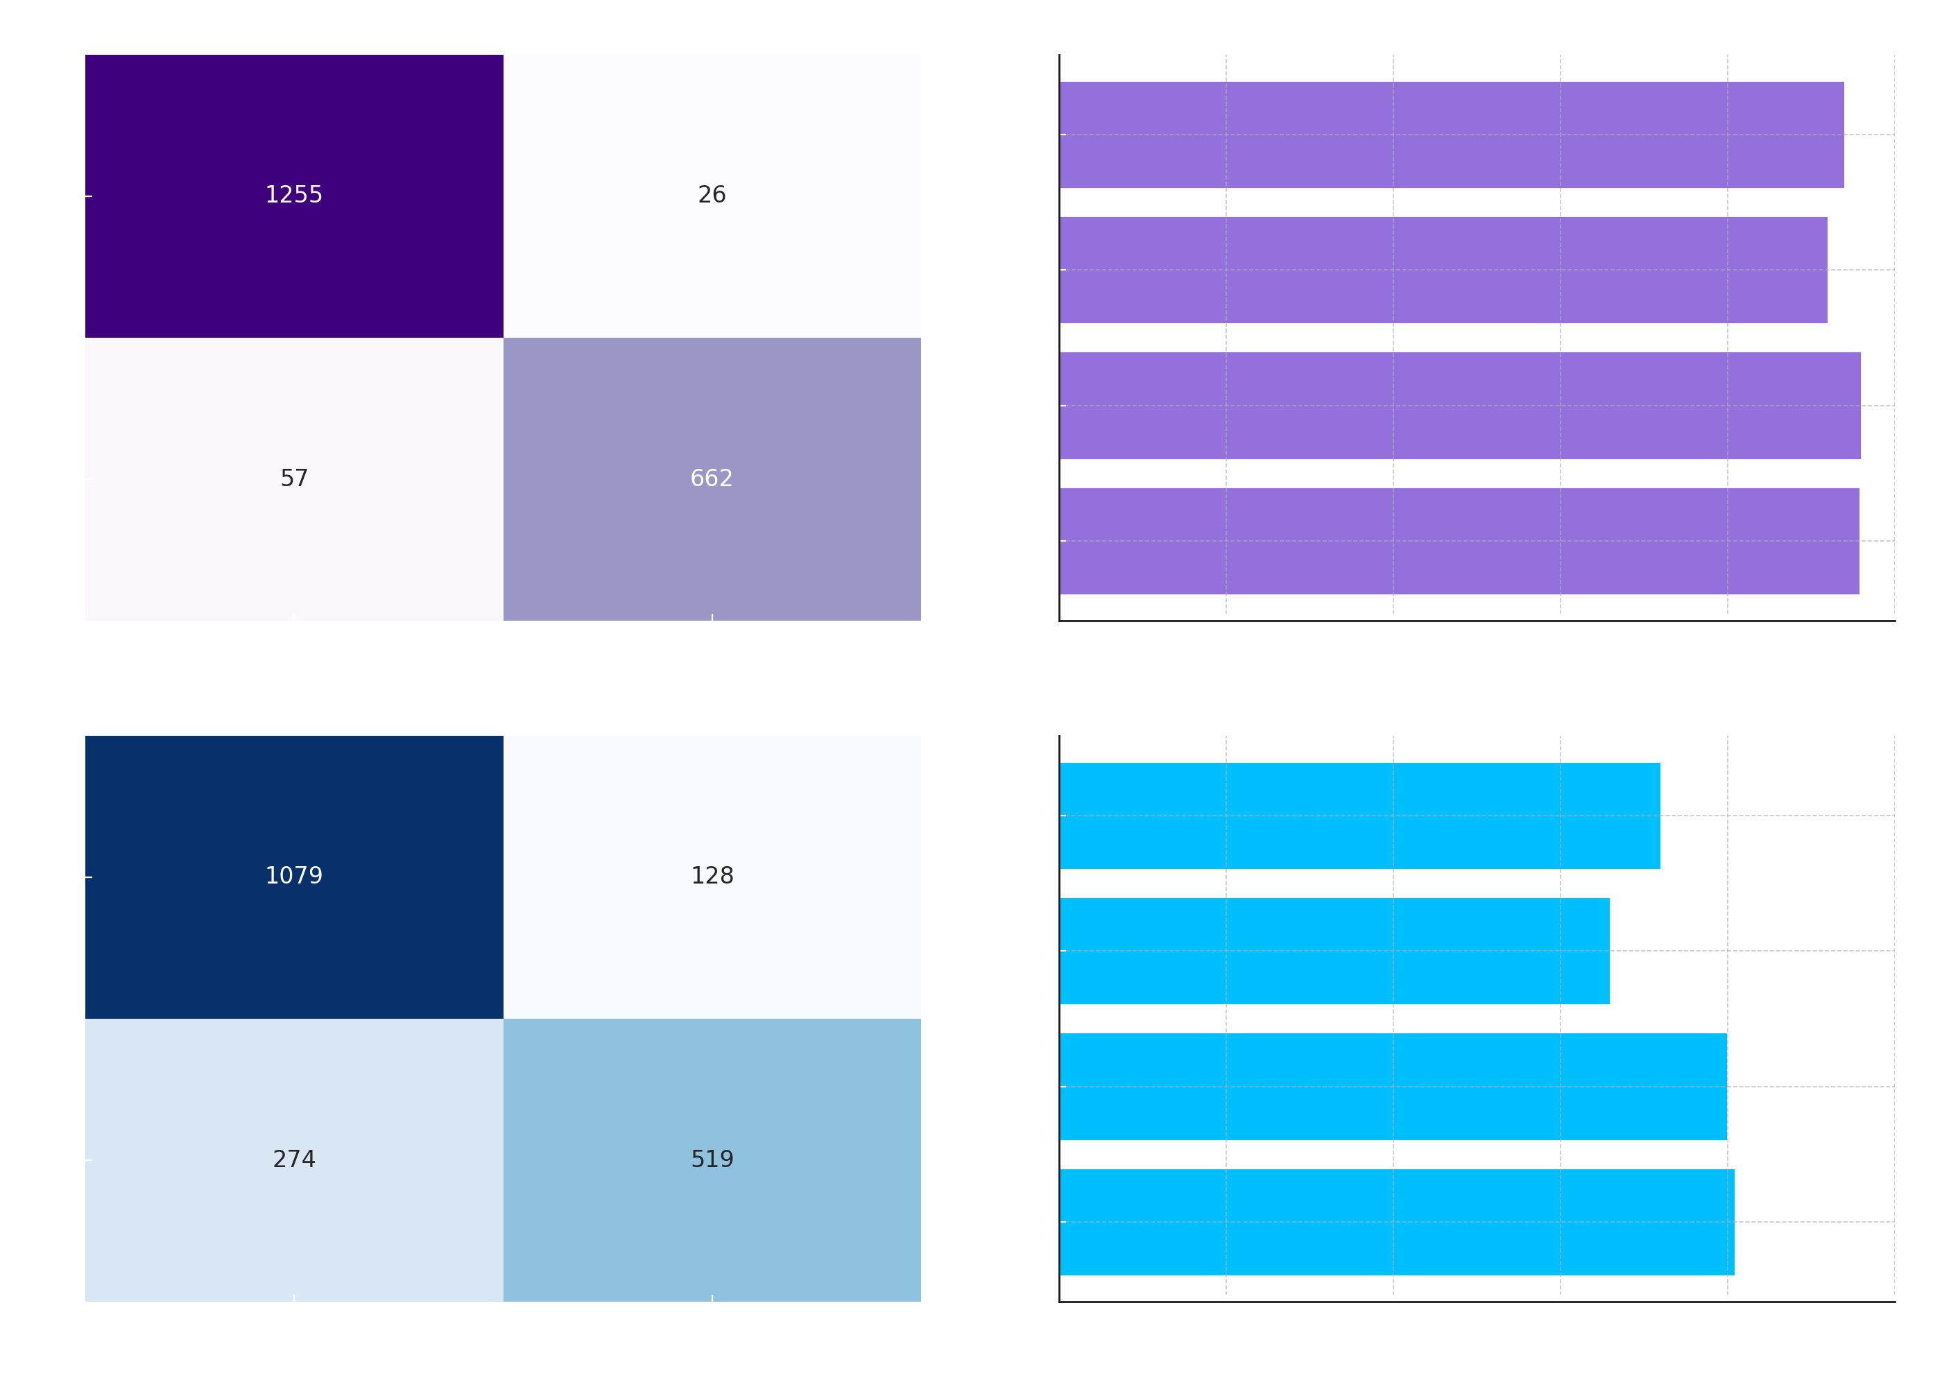
evaluation

Slide 13
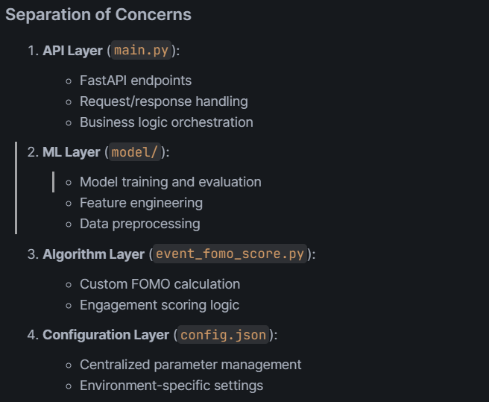
Architecture

Slide 14
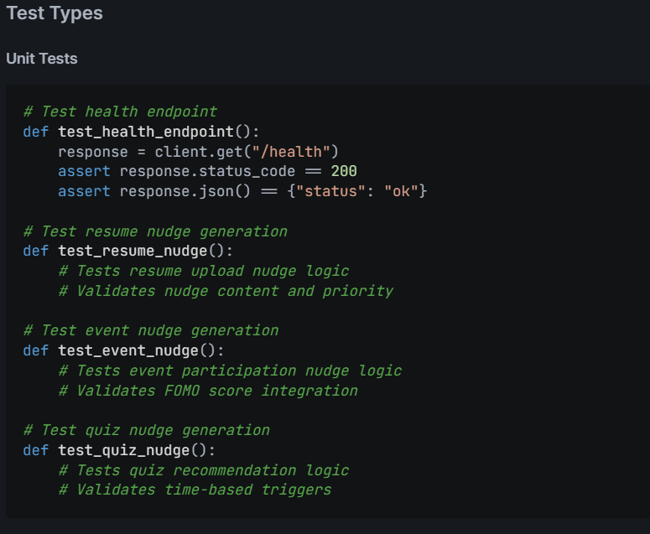
Testing

Slide 15
conclusion
The Engagement Insight Engine effectively optimizes user engagement by integrating intelligent nudge generation through a blend of rule-based logic and machine learning predictions. It delivers context-aware, personalized recommendations using scalable, containerized FastAPI microservices. With robust ML models achieving 96% accuracy for resume nudges and 81% for event-based predictions, the engine overcomes challenges like data imbalance through balanced sampling, ensures sub-second response times, and maintains model interpretability via feature importance from Random Forests. The system is production-ready with Docker deployment, health checks, and comprehensive test coverage, ensuring both reliability

Slide 16
THANK YOU
Ramesh Kuntigorla
dhanrajramesh22@gmail.com

